Slide 1

From Reviews to Results: Enhancing Hotel Services Through Sentiment Analysis
From Reviews to Results: Enhancing Hotel Services Through Text Analysis
Sentiment vs. Ratings Insights
Here is where your marketing plan begins
Blue 10
Vanshika Bhardwaj, Brian Cooke, Charlie Jubera, Fei Lei, Jackson Swicegood

Slide 2


Case Study
Amanda
Frequent business traveler
“Housekeeping staff doesn’t pay attention to dnd sign,lift doors don’t close, disappointed wifi-service,no scenic view, but friendly staff”

Slide 3
42% of guests rate hotels differently than what their reviews suggest.

Slide 4
Agenda
Discrepancy Analysis
Topic Modeling
Location Analysis
Conclusion and next steps
Questions

Slide 5
Discrepancy Analysis

Slide 6
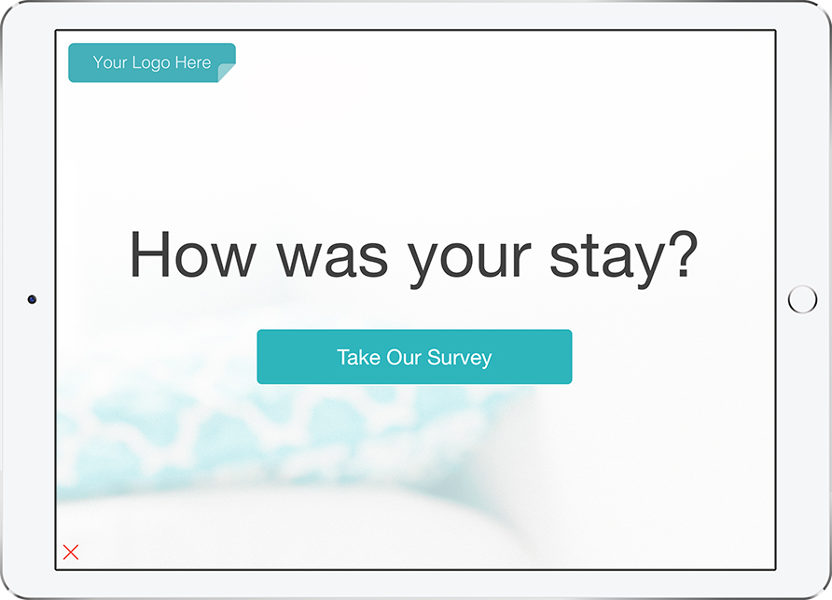
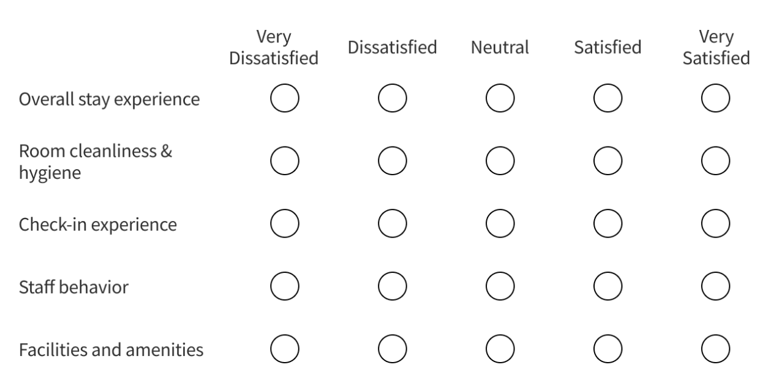
Discrepancy Analysis
Type A
Type B
High rating with low or neutral sentiment
Low rating with high sentiment
75% reviews
25% reviews
Discrepancy Analysis
Topic Modeling
Location Analysis
Conclusion and Next Steps

Slide 7
Topic Modeling

Slide 8
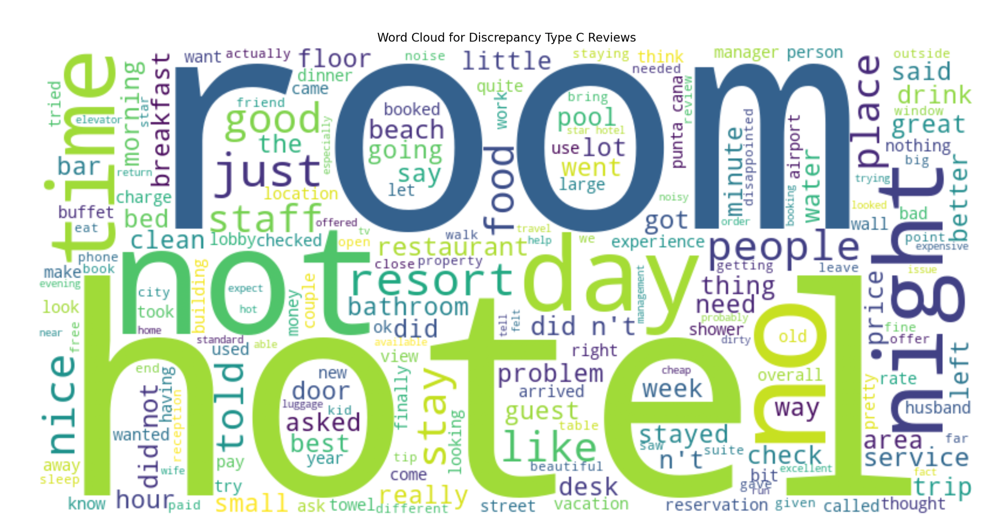
Topic Modeling
small
Discrepancy Analysis
Topic Modeling
Location Analysis
Conclusion and Next Steps

Slide 9
Frequently Mentioned Topics
small
Discrepancy Analysis
Topic Modeling
Location Analysis
Conclusion and Next Steps

Slide 10
Location Analysis

Slide 11
Location Analysis
Analyze locational text elements in reviews
Identify locations with the highest frequencies of Type A discrepancies
Investigate potential issues related to these discrepancies
Discrepancy Analysis
Topic Modeling
Location Analysis
Conclusion and Next Steps

Slide 12





Type A Discrepancy Proportions by Country
United States
United Kingdom
France
Spain
China
13.4%
4.2%
2.8%
2.8%
2.5%
Five countries make up over 25% of all Type A discrepancies
Discrepancy Analysis
Topic Modeling
Location Analysis
Conclusion and Next Steps

Slide 13
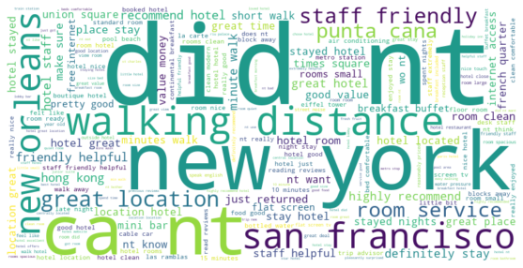
Prominent Positive Topics: Top Five Countries
Discrepancy Analysis
Topic Modeling
Location Analysis
Conclusion and Next Steps

Slide 14
Prominent Issue Topics: Top Five Countries
Hotel staff
Room comments
Walking distance
Negative sentiment indicators (can’t, didn’t)
Discrepancy Analysis
Topic Modeling
Location Analysis
Conclusion and Next Steps

Slide 15
Prominent Issue Topics: Top Five Countries
Hotel staff
Room comments
Walking distance
Negative sentiment indicators (can’t, didn’t)
Discrepancy Analysis
Topic Modeling
Location Analysis
Conclusion and Next Steps

Slide 16
Prominent Issue Topics: Top Five Countries
Hotel staff
Room comments
Walking distance
Negative sentiment indicators (can’t, didn’t)
Discrepancy Analysis
Topic Modeling
Location Analysis
Conclusion and Next Steps

Slide 17
Prominent Issue Topics: Top Five Countries
Hotel staff
Room comments
Walking distance
Negative sentiment indicators (can’t, didn’t)
Discrepancy Analysis
Topic Modeling
Location Analysis
Conclusion and Next Steps

Slide 18
Conclusion

Slide 19
Conclusion
Customers often rate their hotel experiences differently than their actual review sentiment suggests
Even highly rated reviews frequently contain complaints, pointing to unresolved issues that hotels still need to address
Discrepancy Analysis
Topic Modeling
Location Analysis
Conclusion and Next Steps

Slide 20
Next Steps
For hotels:
Customer service training
Look into improving their chains globally
Make sure hotels are adequately staffed especially at peak times.
For customers:
Read reviews, not just ratings
Check reviews across different platforms to see if the feedback is consistent across the board
Discrepancy Analysis
Topic Modeling
Location Analysis
Conclusion and Next Steps

Slide 21
Questions?

